Slide 1

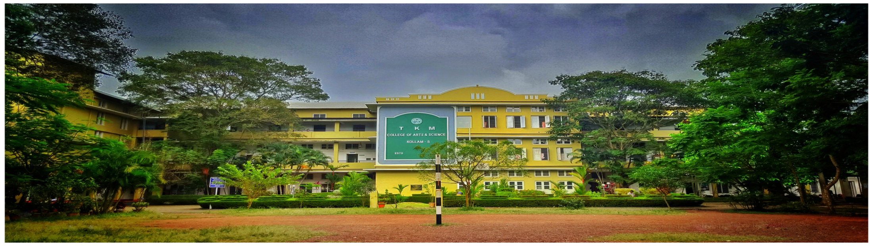
T. K. M. COLLEGE OF ARTS AND SCIENCE, KOLLAM
Department of Chemistry
Organometallic Reagents in Organic Synthesis
Certificate Course in Chemistry
Course Coordinator : Dr. Simimole H.
Course Duration : 30 Hours

Slide 2
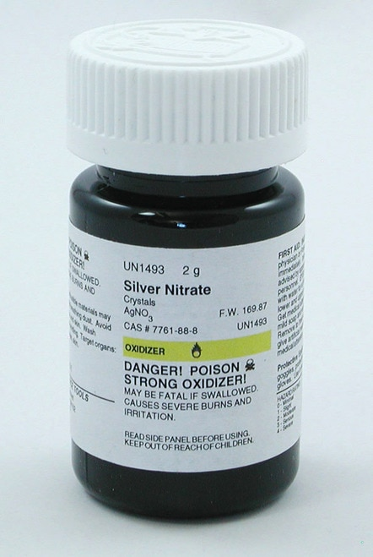
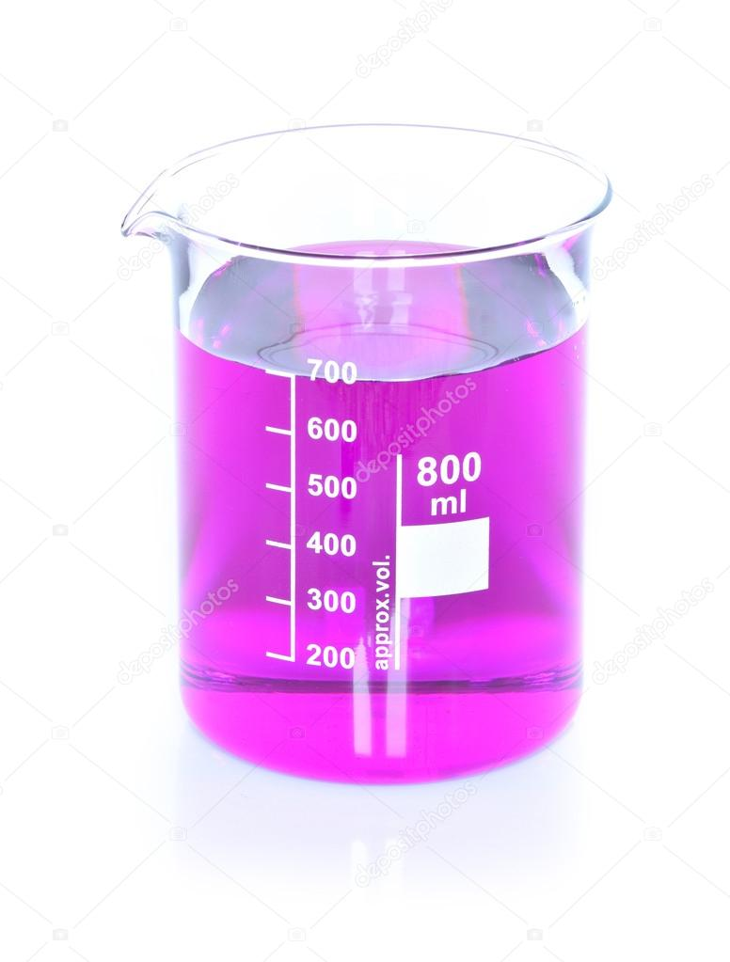
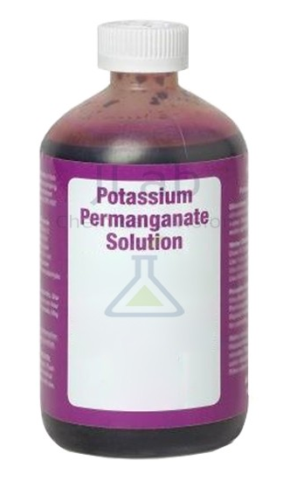
AIM
This course will deal with the various synthetic strategies using organometallic reagents. Both classical and advanced reagents shall be discussed emphasizing on the mechanistic details. Students preparing for CSIR/UGC, GATE and other competitive examination will find this course extremely useful. Along with the reagents in organic synthesis this course provides a broad overview of the generic concepts of design research and design research methodology. It then takes the student through each step of the methodology, from understanding design as a phenomenon, to improving any of its facets in a systematic way and validating the improvements in a methodical manner.

Slide 3
Expected Course Outcome
Upon completion of the course the students will be able to:
  Describe methods for synthesis and transformation of the most common functional
  groups
  Apply organometallic reagents and reactions in organic synthesis
  To know synthetically the processes relevant to organic-chemical reactions and be able
  to discuss the mechanism of these reactions
  Plan and carry out fundamental organic transformations of significance for organic Synthesis
Discuss stereochemical problems related to chemical transformations
  Understand a general definition of research design.
  To carry out simpler risk assessment, in-session laboratory documentation and
  oral/written presentation of the contents and results of laboratory sessions
  Conducting a literature review for a scholarly educational study:
  Familiar with the steps involved in identifying and selecting a good instrument to use
  in a study.

