Slide 1

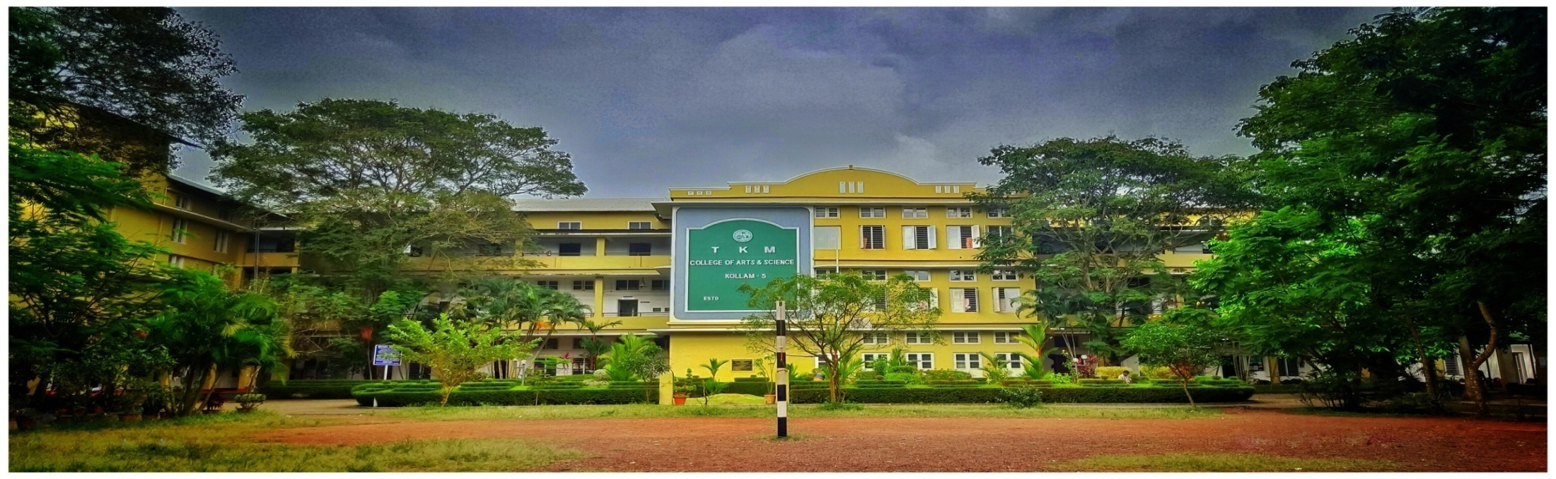
GREEN AGROCHEMISTRY:
Advancing Agricultural Sustainability
T. K. M. COLLEGE OF ARTS AND SCIENCE, KOLLAM
Department of Chemistry
Course Coordinator : Ms. Shrifa Rahim
Course Duration : 30 Hours

Slide 2
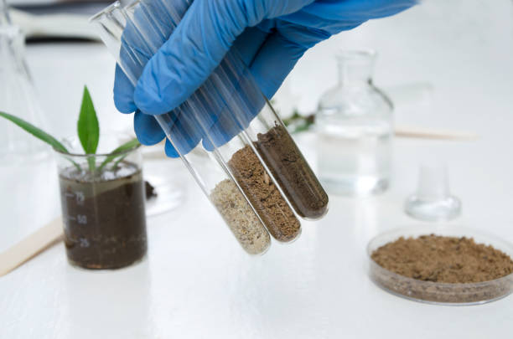
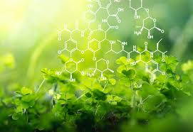
OBJECTIVE
➢ To introduce the various concepts of Agrochemistry and to impart knowledge about physical properties of soil and processes in relation to plant growth.
➢ To give awareness to the students about excess use, adverse effects and remedies of Pesticides, Insecticides etc.
➢ To provide knowledge about the major research areas in agricultural Chemistry

Slide 3
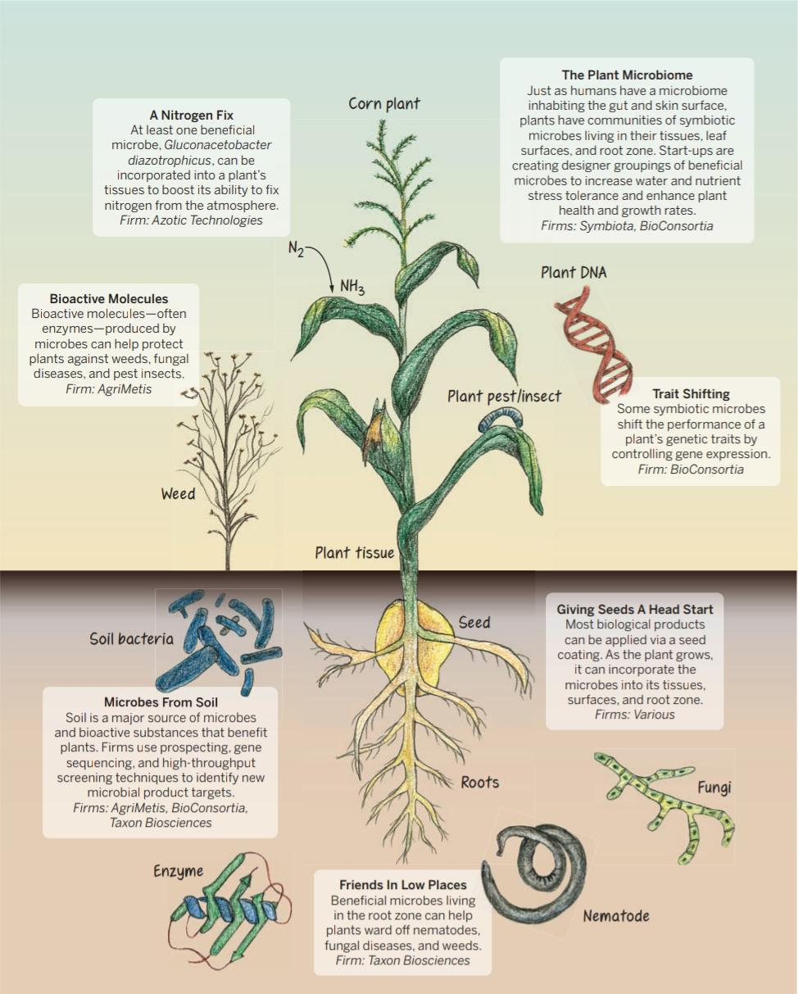
Reprinted in part from C&EN, 2015 93 (19) 10

Slide 4
COURSE OUTCOME
Upon completion of the course the students will be able to:
Understand the basics of Agricultural Chemistry
Understand the role of manures and fertilizers in supplying nutrients to plants.
Evaluate the importance of Instrumental techniques and analytical methods in the field of Agricultural Chemistry.
Explain the Importance of Chemistry in Agricultural Science.
Understand the major research areas in Agrochemistry and thus gives a real inspiration to the students to this area.

